Slide 1
CRIME ANALYSIS AND PREDICTION USING MACHINE LEARNING
Presented By
Vennela Madamshetty 700736655

Slide 2
CONTRIBUTION
Building different kinds of machine learning models of Decision Trees, KNN classifier, and Naïve Bayes classifier which predicts the likelihood of occurrence of a crime.
Few of the visualizations use factors that have the highest impact which gives a proper picture of the analysis.

Slide 3
MOTIVATION
Crime prediction and criminal identification are major concerns for law enforcement agencies.
Police can use gadgets like body cameras and phone taps, but they function independently and are time-consuming.
Data mining tools can provide information on criminal hotspots and concentrations of crime.
Machine learning can identify patterns and relationships in crime data.
Computational algorithms are needed to process data and provide useful information for crime prevention and prediction.

Slide 4
OBJECTIVES
Predicting hotspots of crime.
Understanding crime patterns.
Classify the kind of crime likely to occur based on location.
Analysis of crime rate in different regions.
Predicting crime before it takes place.

Slide 5
RELATED WORK
Multiple supervised and unsupervised learning techniques have been applied to criminal records to discover patterns and connections between crimes for increasing predictive accuracy.
Different classification methods, including K-Nearest Neighbor, Decision tree, Naive Bayes, Adaboost, Random Forest, and K-means clustering, have been utilized to forecast crime in different regions, and their accuracy ranges from 70% to 81%.
Machine learning techniques have been used to classify crimes according to their timing and location, and generate crime locations on a geographical map to facilitate effective policing.
However, imbalanced classes and socio-economic factors affecting crime are still challenges that need to be addressed.
The K-means clustering technique has limitations due to its dependence on initial values and variability in the size and density of clusters, which need to be generalized for better results.

Slide 6
PROBLEM STATEMENT
To develop accurate and reliable algorithms that can predict crime hotspots, identify crime patterns, and provide insights into the socio-economic factors that contribute to criminal activities.
The algorithms must be capable of analyzing diverse data sources such as mobile network activity, criminal records, and road accident patterns to detect patterns and correlations that can aid in crime prevention.
The algorithms must also be scalable, adaptable, and able to handle large and complex datasets.
The ultimate goal is to develop a system that can provide actionable intelligence to law enforcement agencies and contribute to making communities safer.

Slide 7
PROPOSED SOLUTION
Data collection: Gathering relevant data from multiple sources, including crime records, socio-economic data, and other relevant information.
Data preprocessing: Cleaning and processing the collected data to remove any inconsistencies or errors.
Feature selection: Selecting the most relevant features that can contribute to crime prediction accuracy.
Model selection: Evaluating various machine learning models to determine the most suitable one for the problem at hand.
Model training: Training the selected machine learning model on the preprocessed and selected features.
Model evaluation: Evaluating the trained model's performance using appropriate metrics to determine its accuracy.
Crime prediction: Using the trained model to predict future crime trends and hotspots.
Visualizations: Creating visualizations such as heat maps and graphs to help law enforcement agencies better understand and act upon the predicted crime trends.
Improvement: Continuously improve the model's performance by incorporating new data and refining the model's parameters.

Slide 8
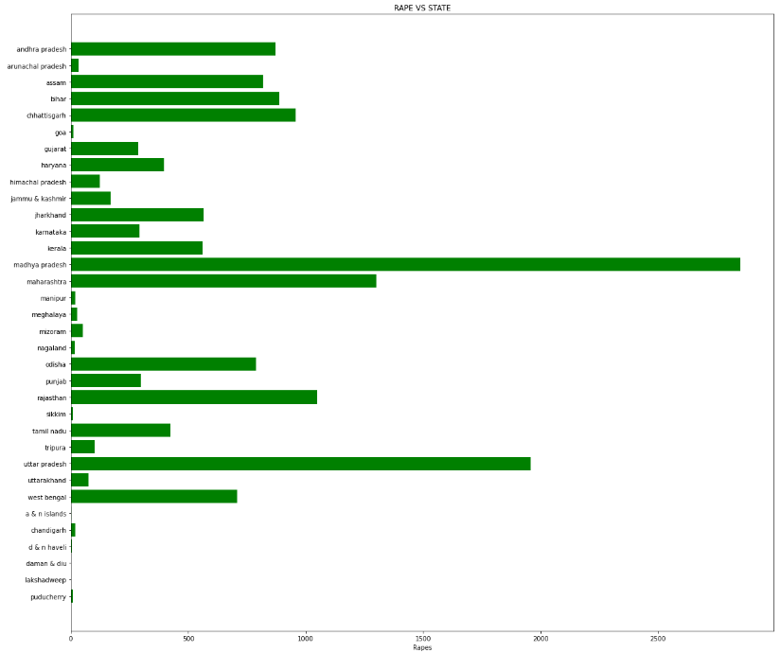
RESULTS
VISUALIZATIONS
RATE OF OCCURRENCE OF RAPES PER STATE

Slide 9
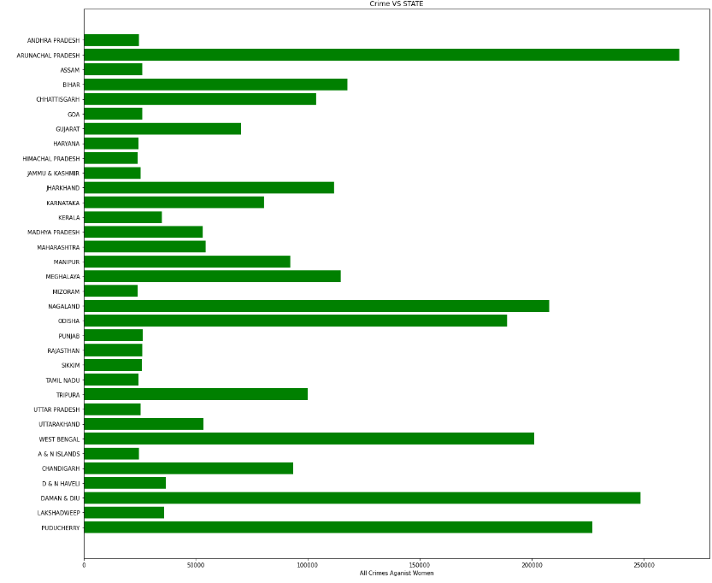
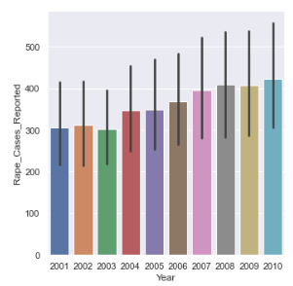
RESULTS CONTD.

Slide 10
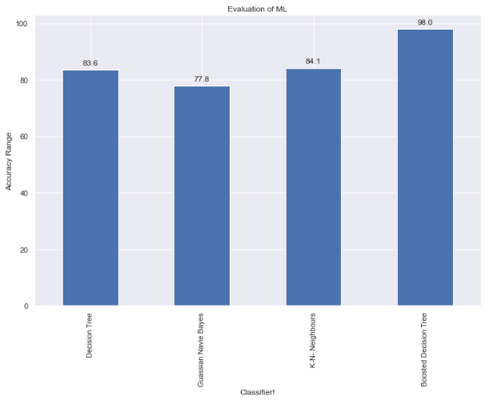
Comparison of performances of different machine learning models.

Slide 11
REFERENCES
Bharati, & RA. K. (2018, September). Crime Prediction and Analysis Using Machine Learning. International Research Journal of Engineering and Technology (IRJET), 5(9). https://www.irjet.net/archives/V5/i9/IRJET-V5I9192.pdf
Pratibha, Gahalot, A., Uprant, Dhiman, S., &; Chouhan, L. (2020). Crime prediction and analysis. 2nd International Conference on Data, Engineering and Applications (IDEA). https://doi.org/10.1109/idea49133.2020.9170731
Shah, N., Bhagat, N., &; Shah, M. (2021). Crime forecasting: A machine learning and computer vision approach to crime prediction and prevention. Visual Computing for Industry, Biomedicine, and Art, 4(1). https://doi.org/10.1186/s42492-021-00075-z

Slide 12
THANK YOU

